Slide 1
BST 261 : Data Science II
Lecture 12
April 25, 2018
Mohammad Jouni
VP Engineering & Data Science @ Wellframe
MIT SM ’17

Slide 2
LSTM & GRU

Slide 3
Agenda
Intro
ANNs vs RNNs
Vanishing Gradient Problem
Long Short Term Memory (LSTM)
Gated Recurrent Unit (GRU)
LSTM vs GRU

Slide 4
ANNs vs RNNs

Slide 5

ANNs vs RNNs
ANNs are great for problems where the input is fixed size, i.e. all data needed to determine the output can be consumed in one shot
What if the output depends on multiple sequential “steps”?

Slide 6

ANNs vs RNNs
Credit: Andrej Karpathy

Slide 7
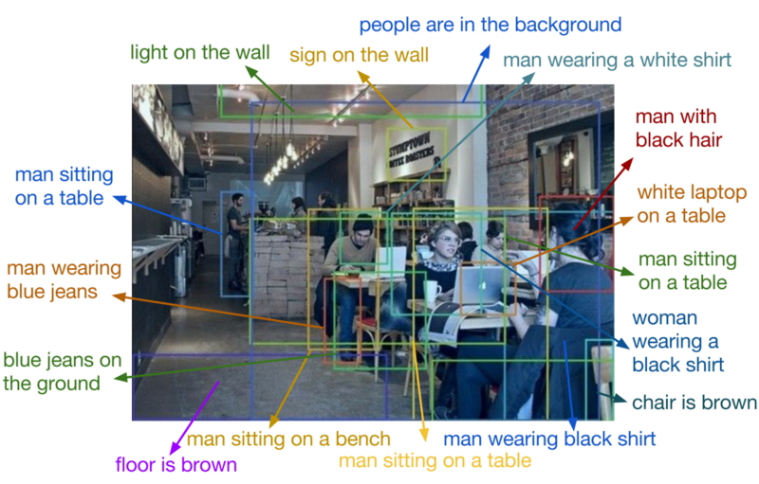

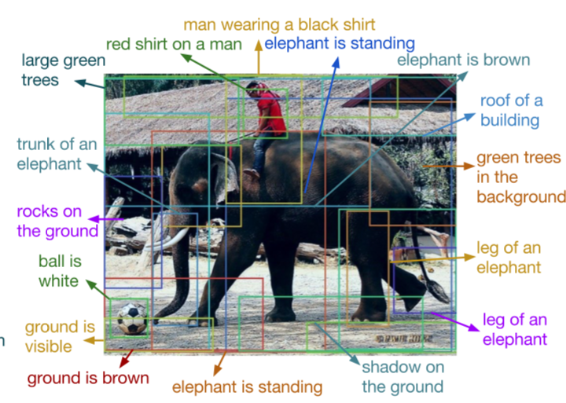
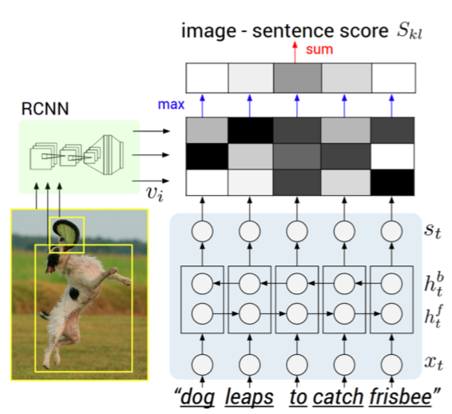
ANNs vs RNNs
Ex: Image
Captioning

Slide 8
ANNs vs RNNs
Negative
Ex: Sentiment
Analysis
This
is
not
a
great
book
Positive
This
is
a
good
book

Slide 9
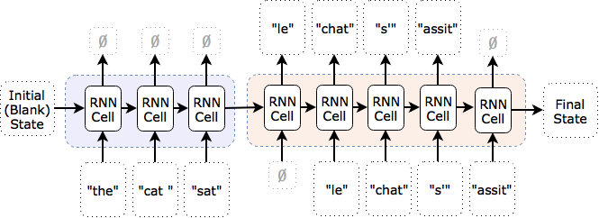
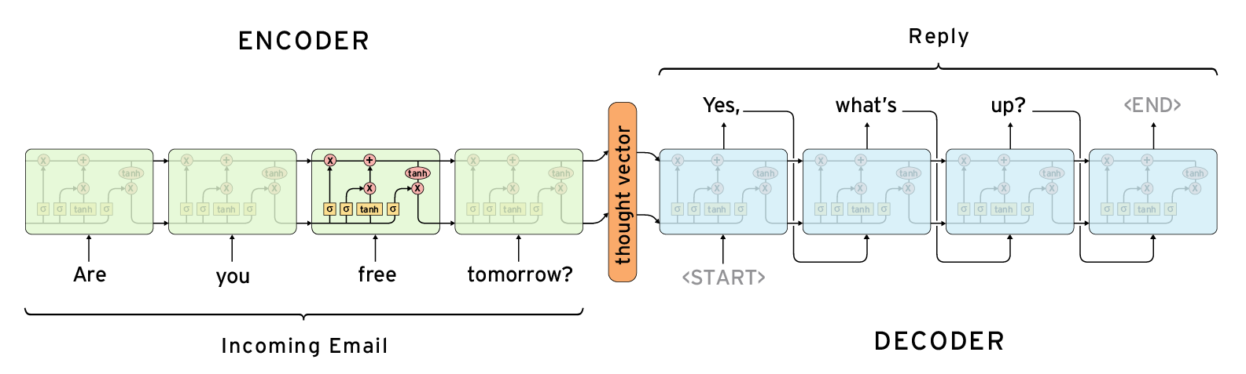
ANNs vs RNNs
Ex: Translation,
automated response

Slide 10
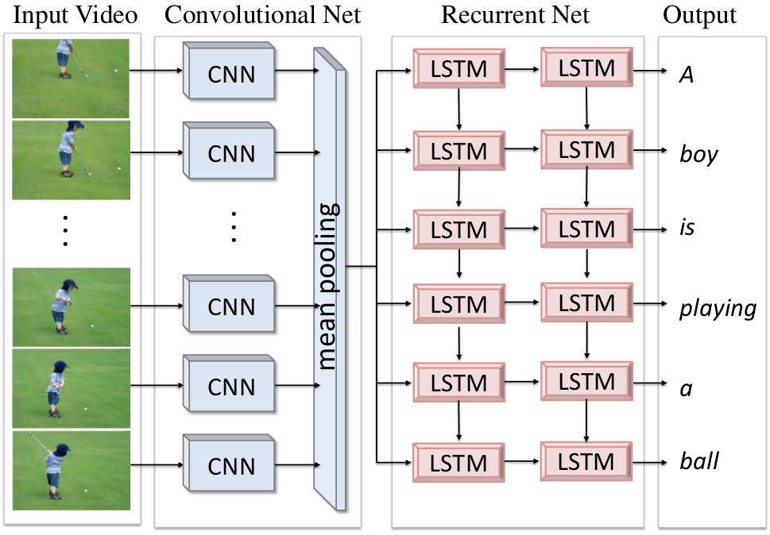
ANNs vs RNNs
Ex: Frame by frame
image captioning

Slide 11
Vanishing Gradient Problem

Slide 12
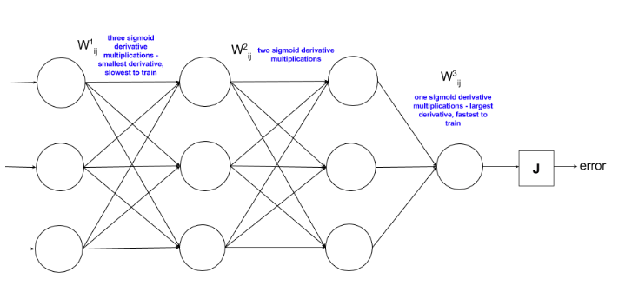
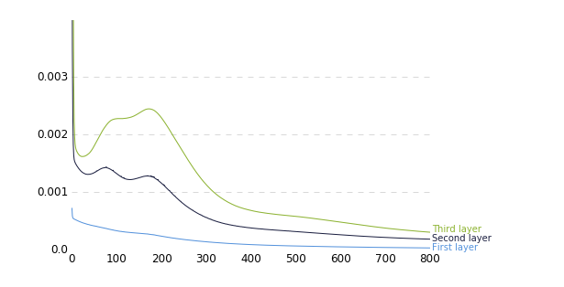
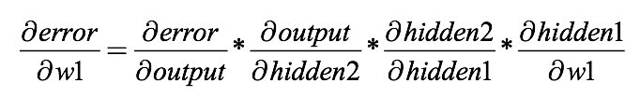
Vanishing Gradient Problem
Backpropagation to train ANNs was described in 1974 by Paul Werbos
Researchers found that when you increase the expressiveness of the network (i.e. add more layers), training times become prohibitive
In 1991, Sepp Hochreiter identified the above problem as the “vanishing gradient problem”

Slide 13
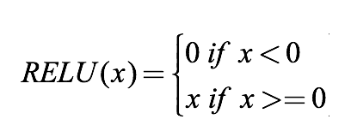
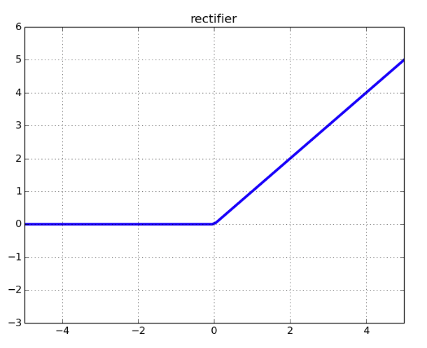
Vanishing Gradient Problem
Using the Rectified Linear Unit (ReLU) as the activation function was the solution for the vanishing gradient problem in deep neural networks
ReLUs are now the most popular activation function for deep neural networks
What about RNNs?

Slide 14
Vanishing Gradient Problem
The longer the number of steps that an RNN captures, the deeper the network, the larger the effects of the vanishing gradient problem

Slide 15
Long Short Term Memory (LSTM)

Slide 16

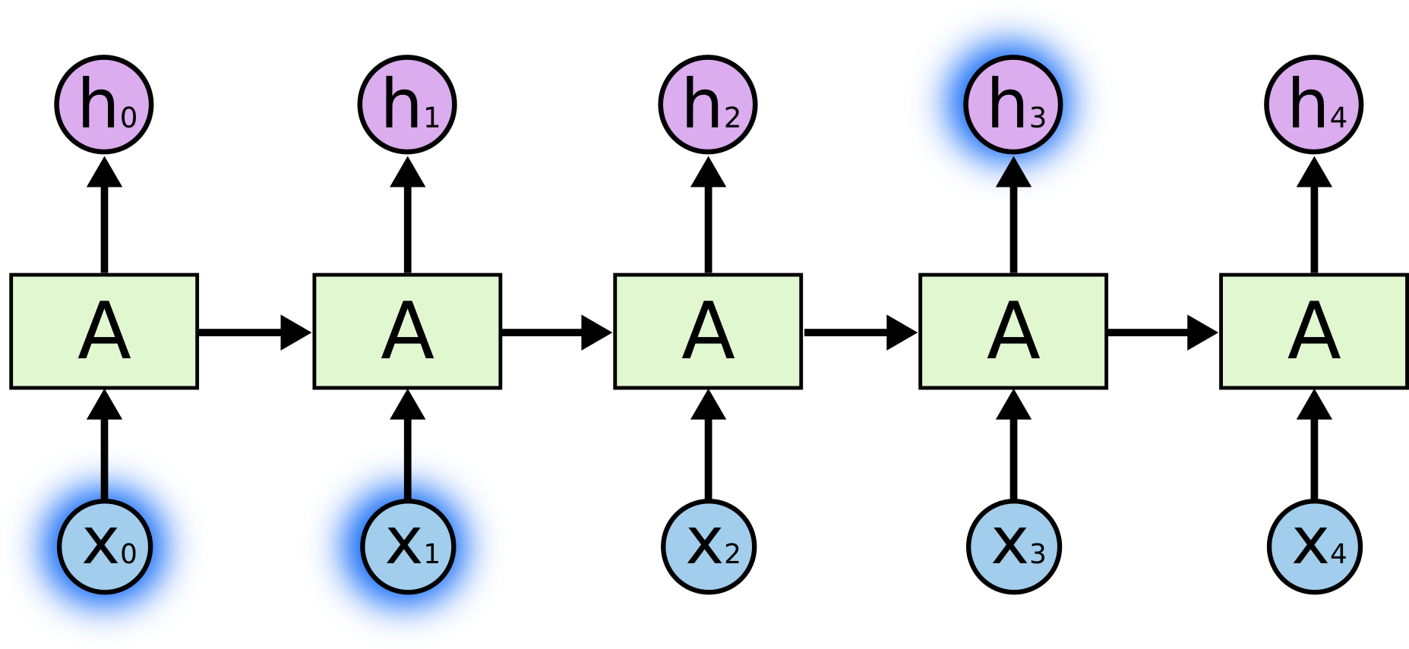
LSTM
An unrolled recurrent neural network
RNN where the output at h₃ only depends on the input from x₀ and x₁

Slide 17
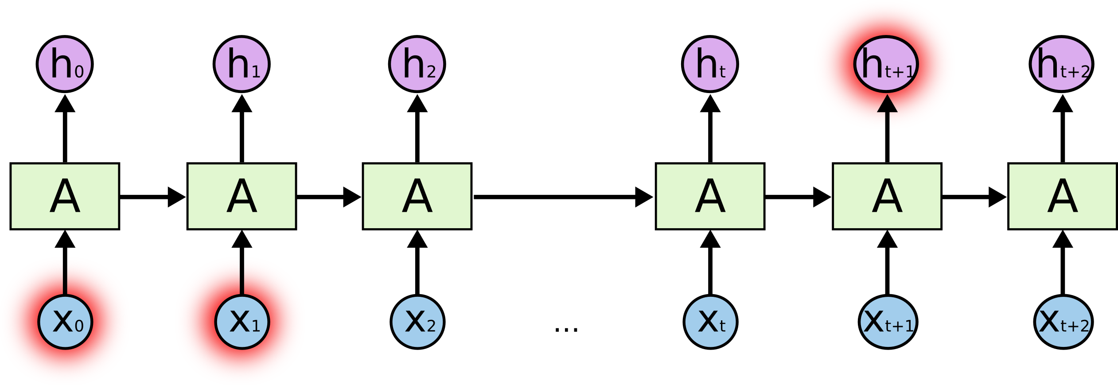
LSTM
RNN where the output at h_{t+1} is dependent on data inputs (x₀ and x₁) that are too far for the gradient to carry

Slide 18



LSTM
Vanilla RNN
RNN with LSTM units

Slide 19




LSTM
Step 1 : Forget Gate – Determine how much of the
previous state should affect the current state based on
the current observed input x_{t}.
Step 2 : Update Cell State – First determine which values we will update (gate i_{t}), hen create a list of candidate values that we will add to the current state (C_{t}) based on the current input (x_{t}) and the previous output (h_{t-1}).
Step 3 : Execute the Update – Update the amount of carried state, then
add the selected new states to the retained state to create the new internal state
Step 3 : Compute Unit Output – Determine what parts of the cell state will be used as unit output,
Notes:
Step 1 : “Let’s go back to our example of a language model trying to predict the next word based on all the previous ones. In such a problem, the cell state might include the gender of the present subject, so that the correct pronouns can be used. When we see a new subject, we want to forget the gender of the old subject.”
Step 2 : “In the example of our language model, we’d want to add the gender of the new subject to the cell state, to replace the old one we’re forgetting.”
Step 3: “In the case of the language model, this is where we’d actually drop the information about the old subject’s gender and add the new information, as we decided in the previous steps.”
Step 4: “For the language model example, since it just saw a subject, it might want to output information relevant to a verb, in case that’s what is coming next. For example, it might output whether the subject is singular or plural, so that we know what form a verb should be conjugated into if that’s what follows next.”

Slide 20
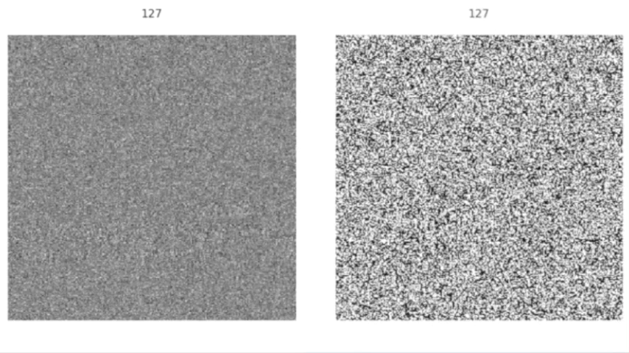
LSTM

Slide 21
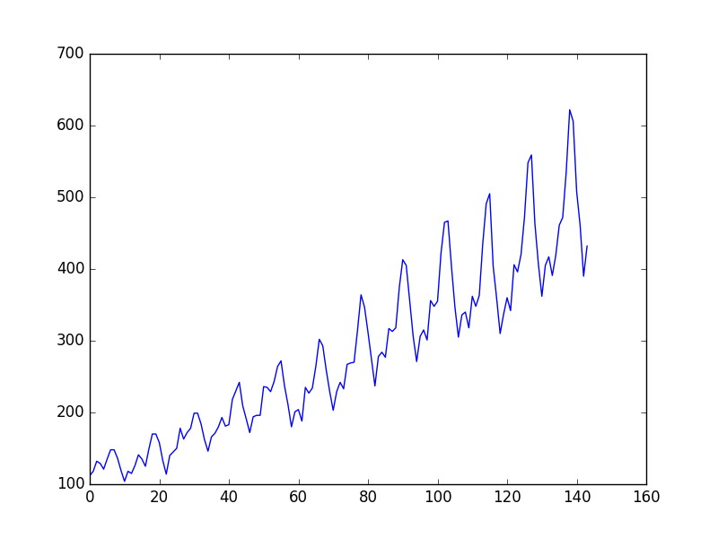
LSTM
“Predict the number of international airline passengers in units of 1,000. The data ranges from January 1949 to December 1960, or 12 years, with 144 observations.”
Plot of the Airline Passengers Dataset

Slide 22
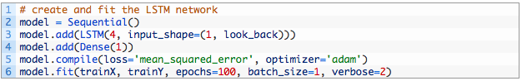
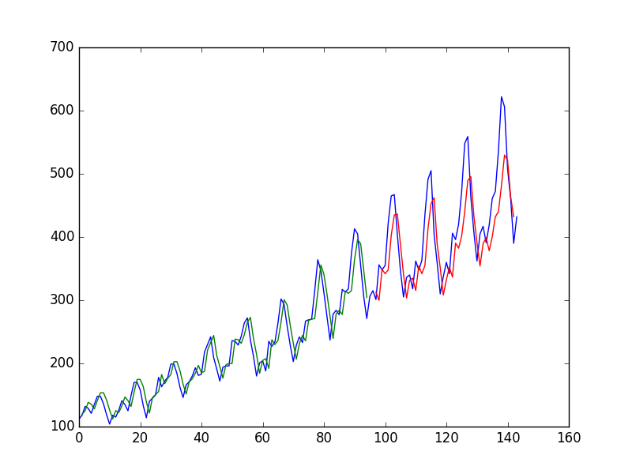
LSTM
LSTM Trained on Regression Formulation of Passenger Prediction Problem
Notes:
The network has a visible layer with 1 input, a hidden layer with 4 LSTM blocks or neurons, and an output layer that makes a single value prediction. The default sigmoid activation function is used for the LSTM blocks. The network is trained for 100 epochs and a batch size of 1 is used.
Predictions for the training dataset in green, and the predictions on the unseen test dataset in red.

Slide 23
Gated Recurrent Network (GRU)

Slide 24

GRU
Relatively new (2014) vs LSTM (1997)
Combined the forget and input gates into an “update gate”
Merges cell state and hidden state
Performance on par with LSTM but computationally more efficient

Slide 25
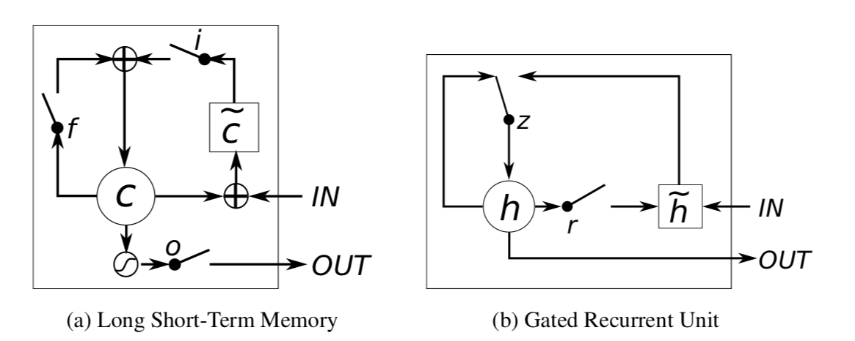
GRU

Slide 26
LSTM vs GRU

Slide 27
LSTM vs GRU
LSTM perform better on long sequences
GRUs are faster to train
GRUs are simpler to understand and modify

Slide 28
Q&A

Slide 29
Sources
https://towardsdatascience.com/applied-deep-learning-part-1-artificial-neural-networks-d7834f67a4f6
https://www.youtube.com/watch?v=yCC09vCHzF8
https://cs.stanford.edu/people/karpathy/cvpr2015.pdf
https://arxiv.org/pdf/1511.07571v1.pdf
https://r2rt.com/written-memories-understanding-deriving-and-extending-the-lstm.html
https://ayearofai.com/rohan-4-the-vanishing-gradient-problem-ec68f76ffb9b
http://harinisuresh.com/2016/10/09/lstms/
http://colah.github.io/posts/2015-08-Understanding-LSTMs/
https://machinelearningmastery.com/time-series-prediction-lstm-recurrent-neural-networks-python-keras/
https://arxiv.org/pdf/1412.3555v1.pdf
https://datascience.stackexchange.com/questions/14581/when-to-use-gru-over-lstm

